Slide 1
Nivolumab vs Everolimus in Advanced Renal Cell Carcinoma: Japanese Subgroup Analysis from the CheckMate 025 Study
Tomita Y, Fukasawa S, Shinohara N, et al. Jpn J Clin Oncol. 2017;47(7):639-646
Notes:
This is a presentation on the study by Tomita and colleagues comparing the efficacy of nivolumab to that of everolimus in the treatment of advanced renal cell carcinoma. This study was a subgroup analysis based on the original CheckMate 025 study, which was the phase III clinical trial for nivolumab.

Slide 2
Chemotherapy is used in advanced stage or unresponsive RCC (aRCC)
Stage III: Tumor outside kidney but inside fascia, or one nodal met¹
Stage II: Tumor > 7 cm and confined to kidney
Stage I: Tumor <7 cm and confined to kidney
Stage IV: Tumor outside fascia, or distant met¹
National Comprehensive Cancer Network. NCCN Guidelines 3.2023 Kidney Cancer. Accessed 11/15/20222
1. Metastasis
Notes:
Let’s start off with a brief overview of the types of patients who would be receiving these treatments. Renal cell carcinoma is staged I through IV. Stages I and II are distinguished by tumor size for tumors inside the kidney, whereas stage III involves extra-renal invasion or nodal metastasis and stage IV involves extra-fascial invasion or distant metastasis.

Slide 3
Chemotherapy is used in advanced stage or unresponsive RCC (aRCC)
Chemotherapy
Stage III: Tumor outside kidney but inside fascia, or one nodal met
Stage II: Tumor > 7cm and confined to kidney
Stage I: Tumor <7cm and confined to kidney
Stage IV: Tumor outside fascia, or distant met
National Comprehensive Cancer Network. NCCN Guidelines 3.2023 Kidney Cancer. Accessed 11/15/2022
Notes:
So, for most patients with stage IV RCC, chemotherapy is the first line of treatment. There are a number of different drug options with different mechanisms which we will get into in a minute. Sometimes for stage IV patients with oligometastatic disease, cytoreductive surgery and metastatectomy is performed, but this is done in addition to chemotherapy.

Slide 4

Chemotherapy is used in advanced stage or unresponsive RCC (aRCC)
Chemotherapy
Stage III: Tumor outside kidney but inside fascia, or one nodal met
Stage II: Tumor > 7cm and confined to kidney
Stage I: Tumor <7cm and confined to kidney
Stage IV: Tumor outside fascia, or distant met
Surgical resection +/- adjuvant chemo if more advanced
National Comprehensive Cancer Network. NCCN Guidelines 3.2023 Kidney Cancer. Accessed 11/15/2022
Notes:
By contrast, Stages I-III of RCC are typically first treated with surgical tumor resection, either a partial or complete nephrectomy, according to the NCCN guidelines. In some more advanced cases, adjuvant chemotherapy is utilized, but for the most part surgical resection is performed with curative intent.

Slide 5
Chemotherapy is used in advanced stage or unresponsive RCC (aRCC)
Chemotherapy
Stage III: Tumor outside kidney but inside fascia, or one nodal met
Stage II: Tumor > 7cm and confined to kidney
Stage I: Tumor <7cm and confined to kidney
Stage IV: Tumor outside fascia, or distant met
Disease progression
Surgical resection +/- adjuvant chemo if more advanced
National Comprehensive Cancer Network. NCCN Guidelines 3.2023 Kidney Cancer. Accessed 11/15/2022
Notes:
If patients with Stage I-III RCC have progression of disease following surgical treatment, which would either consist of local tumor recurrence or distant metastasis, chemotherapy is then initiated as the next line of treatment.

Slide 6
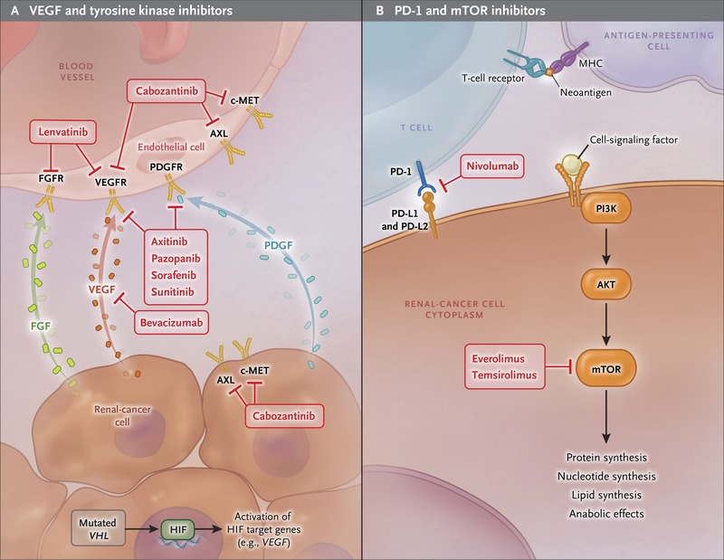
Current targeted therapies for aRCC include VEGF, mTOR, and tyrosine kinase inhibitors
Choueiri TK, Motzer RJ. N Engl J Med. 2017;376(4):354-366
Notes:
In most countries, first line chemotherapy for RCC consists of one or more of several different targeted drugs. Cytokines, such as IL-2, which stimulate the cytotoxic immune response on a systemic level, are sometimes still utilized though they generally have lower efficacy and a bigger side effect profile. Targeted chemotherapies for RCC include those like sorafenib and axitinib that target VEGF, which prevents the neovascularization necessary for tumor growth. Others, like everolimus and temsirolimus, work to inhibit the mTOR protein and thus downregulate the processes of DNA and protein synthesis necessary for the uncontrolled growth seen in tumor cells.

Slide 7
Nivolumab is a novel chemotherapy that blocks PD-1, stimulating antitumor immune response
Choueiri TK, Motzer RJ. N Engl J Med. 2017;376(4):354-366
Notes:
Nivolumab is a novel chemotherapeutic agent which inhibits the binding of PD-1 to PD-L1 and PD-L2 on tumor cells, allowing T cells to recognize the tumor as foreign and stimulate the cytotoxic immune response.

Slide 8
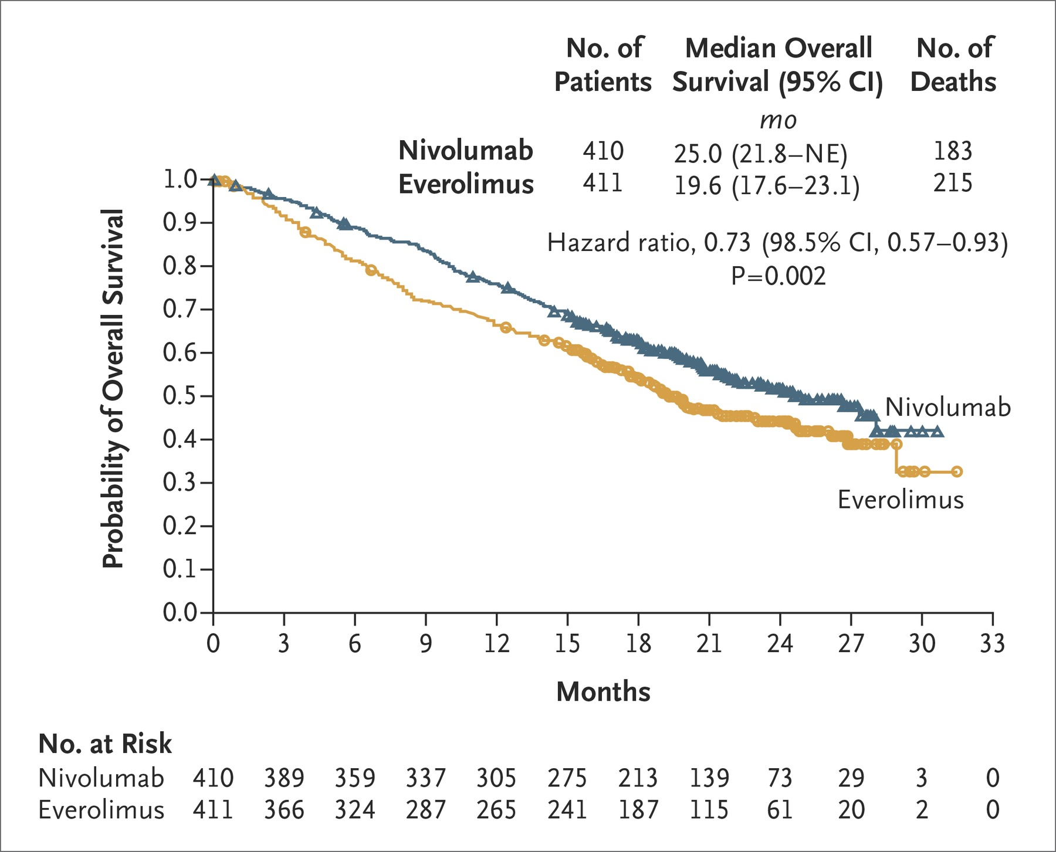
Original CheckMate 025 study showed better overall survival (OS) and objective response rate (ORR) for nivolumab over everolimus
ORR: 25% vs. 5%; odds ratio, 5.98 [95% CI, 3.68 to 9.72]; P<0.001
Motzer RJ, Escudier B, McDermott DF, et al; CheckMate 025 Investigators. N Engl J Med. 2015;373(19):1803-1813
Notes:
The original CheckMate 025 study, upon which this study is based, showed that the new agent nivolumab significantly improved overall survival and the objective response rate when compared to everolimus as a second line treatment of advanced RCC.

Slide 9
Japanese patients with aRCC differ from others around the world
Baseline characteristics
More favorable risk scores
Prior treatments
More likely to use cytokines as first line
Adverse events
Genetics may increase risk of high-grade skin rash with sorafenib
Better baseline functional status
Ye D, Eto M, Chung JS, et al. Clin Genitourin Cancer. 2014;12(4):225-233
Tsuchiya N, Narita S, Inoue T, et al. Anticancer Drugs. 2013;24(3):310-314
Tomita Y, Fukasawa S, Shinohara N, et al. Jpn J Clin Oncol. 2017;47(7):639-646
Notes:
However, it is not a foregone conclusion that the Japanese population would have the same response to nivolumab as patients from other parts of the world. Japanese patients with aRCC who go on chemotherapy tend to have lower risk scores and a better functional status at the time of treatment initiation. Additionally, Japanese patients are more likely to have been treated with a cytokine as a first-line chemotherapeutic agent. Finally, the specific genetics of Japanese patients has been shown to increase the risks of certain side effects of other chemotherapeutic agents, and therefore it is reasonable to assume they might respond differently to new drugs.

Slide 10
This study performed a subgroup analysis of Japanese patients treated with second line nivolumab vs everolimus
Primary endpoint
Overall survival, 26 month minimum follow up
Secondary endpoints
Objective response rate
Progression free survival
Adverse events
Tomita Y, Fukasawa S, Shinohara N, et al. Jpn J Clin Oncol. 2017;47(7):639-646
Notes:
Given this, the current study sought to analyze the efficacy and side effects of nivolumab as a second line chemotherapeutic in the Japanese population as compared to everolimus. The primary endpoint was overall survival, and secondary endpoints were ORR, progression free survival, and the occurrence of adverse events

Slide 11



Japanese patients comprised a small subgroup with slight baseline differences
37/410 (9%) nivolumab and 26/411 (6%) Everolimus patients
Higher baseline Karnofsky performance status
Higher rates of prior treatment with axitinib, interferon-α, sorafenib
Tomita Y, Fukasawa S, Shinohara N, et al. Jpn J Clin Oncol. 2017;47(7):639-646
Notes:
Looking at the population of Japanese patients, we see they comprised a small proportion of study participants. As expected, they had a higher baseline functional status prior to treatment, and were more likely to have been treated with cytokines initially.

Slide 12
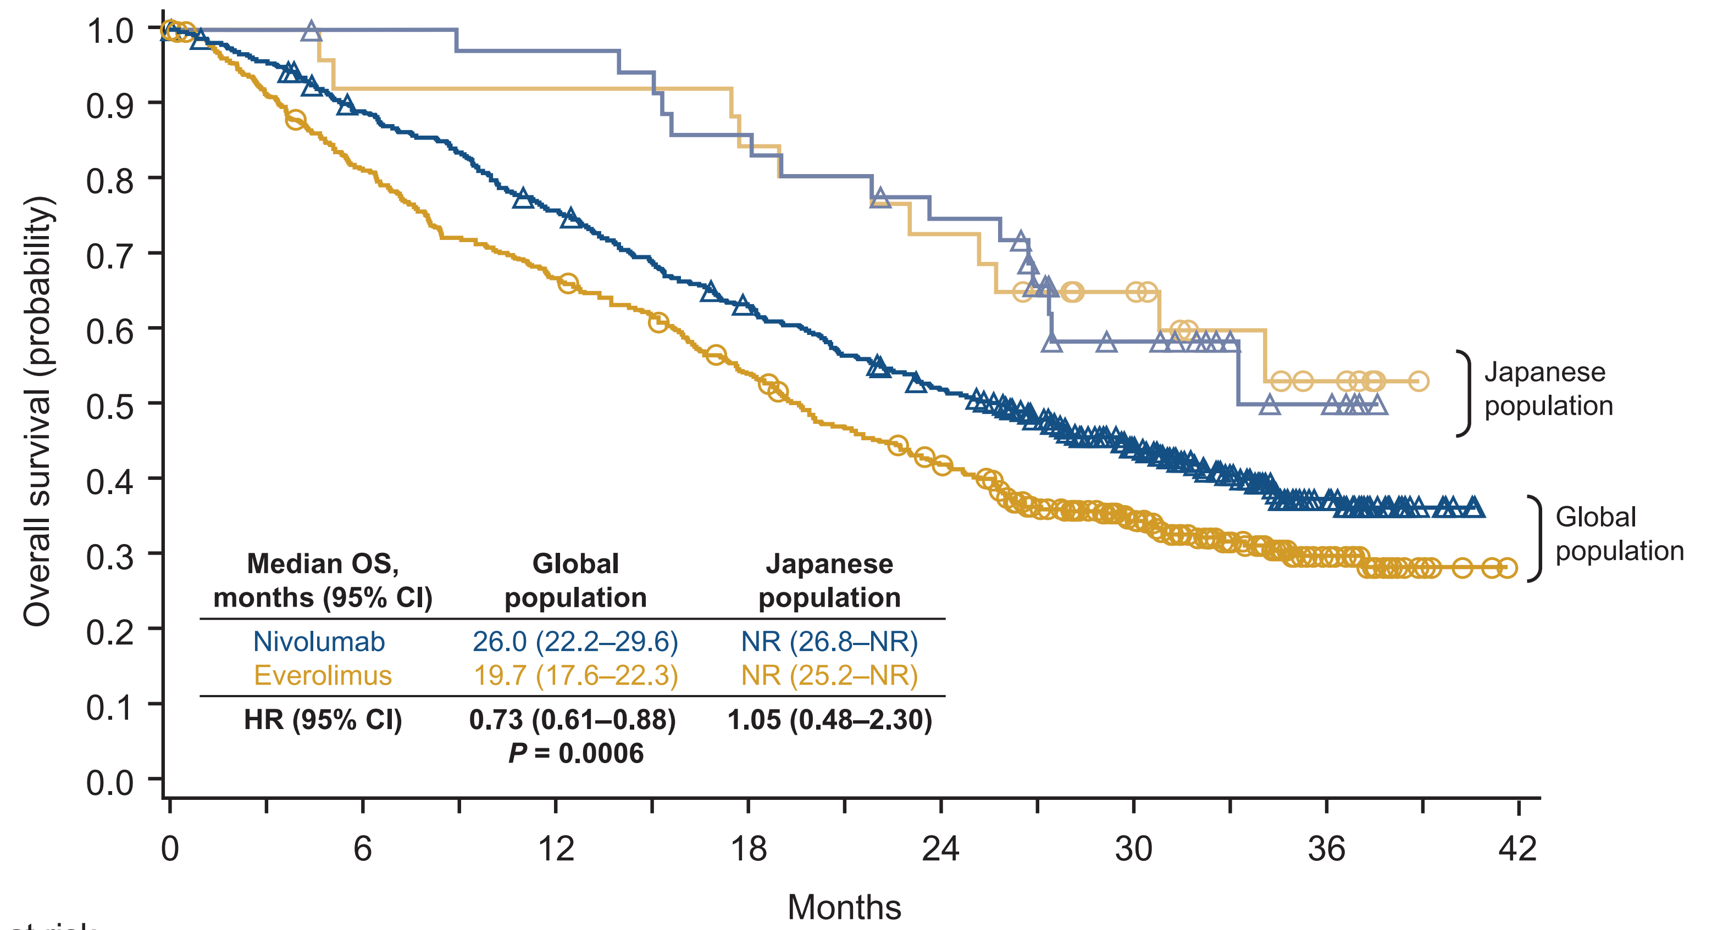
Japanese patients had better OS in both groups, but median OS was not reached in either
Tomita Y, Fukasawa S, Shinohara N, et al. Jpn J Clin Oncol. 2017;47(7):639-646
Notes:
The Japanese patients had better overall survival on both treatments as compared to the global population. Due to this, the median overall survival in the nivolumab and everolimus treatment arms was not reached

Slide 13
Japanese patients had better ORR with Nivolumab
P < 0.0001
Tomita Y, Fukasawa S, Shinohara N, et al. Jpn J Clin Oncol. 2017;47(7):639-646
Notes:
As was seen with the global population, ORR was higher among Japanese patients treated with nivolumab.

Slide 14
Adverse events were more common with Everolimus, particularly those grade 3-4
Stomatitis most common with Everolimus (77%)
Diarrhea most common with Nivolumab (19%)
Tomita Y, Fukasawa S, Shinohara N, et al. Jpn J Clin Oncol. 2017;47(7):639-646
Notes:
There was a trend towards lower rates of adverse events in Japanese patients treated with nivolumab as compared with everolimus. This effect was more pronounced when looking at the more severe adverse events. The most common adverse event with everolimus was stomatitis, whereas the most common one with nivolumab was diarrhea.

Slide 15
Conclusions: Japanese patients had better survival and risk-benefit profile on nivolumab
Conclusions limited by small subpopulation
Better baseline characteristics may explain improved survival for all treatments
Treatment regimens remain diverse, with several effective options
Tomita Y, Fukasawa S, Shinohara N, et al. Jpn J Clin Oncol. 2017;47(7):639-646
Notes:
To sum this study up, the Japanese subgroup in this study had better survival overall on both agents. This very well may be explained by the better baseline characteristics of this population. There was a trend towards a higher ORR and lower rates of adverse events with nivolumab. The study is limited by the small size of the Japanese cohort.
Thus, chemotherapeutic treatment for advanced RCC in Japanese patients remains diverse, with several effective options with differing mechanisms of action available to clinicians.

